Slide 1
AI Chatbot for Pros & Cons of Living in Germany
🚀 A Smart AI-Powered Solution for Fast & Accurate Insights!
Mehak

Slide 2


🏆 Why This Chatbot?
“Ever wondered what life in Germany is like? Now imagine having a chatbot that gives you personalized, detailed insights in seconds!“
❌ Problem: People spend hours watching videos to understand life in Germany. ✅ Solution: Our AI chatbot instantly extracts key insights, summarizing pros and cons from real-world YouTube videos!
💡 "Tired of long videos? Get key insights in seconds!" 🔍 Accurate: Uses AI & RAG to pull insights from real-life experiences. ⏳ Saves Time: No need to watch long videos—get instant answers. 🌍 Scalable: Can adapt to any country, topic, or industry.

Slide 3
Overview of the System Architecture
📚 Retrieve Relevant Transcripts
🛠 Agent Processes Query (RetrievalQA)
📥 User Query
🔍 Similarity Search (Pinecone)
📤 Displayed via Gradio UI
🧠 LLM (GPT-3.5 Turbo) + Memory (Buffer)
💬 Response Generated

Slide 4

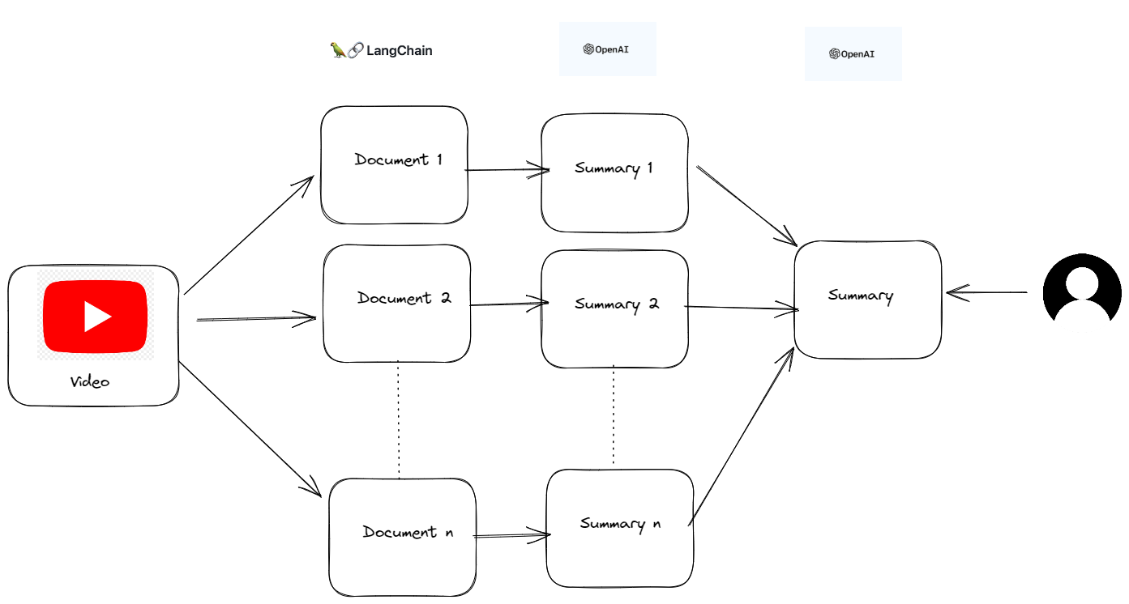
Fetching YouTube Video Transcripts(Dataset)
Code Explanation:
YouTubeTranscriptApi: Retrieves subtitles for videos using their unique IDs.
Example Input: ['2u4ItZerRac', 'I2zF1I60hPg', ...].
Code Sample:
python
transcript_data = YouTubeTranscriptApi.get_transcript(video_id)
Outputs: Raw text transcripts combined into full video summaries.
Challenges:
Some videos may not have transcripts.
Errors due to unavailable subtitles are handled with try-except.

Slide 5

Q&A Agent Architecture 🧠
🤖 AI-Powered Retrieval
💡 Uses Retrieval-Augmented Generation (RAG) for context-aware answers.
🛠️ Key Components
Memory: Conversation Buffer Memory (remembers last 5 interactions).
Retriever: Pinecone vector search for most relevant answers.
Chat Model: GPT-3.5: Processes user queries and generates responses
📌 LangChain’s RetrievalQA manages search and answer generation.
Tools: Integrated LangChain’s RetrievalQA with Pinecone to retrieve
transcripts relevant to user queries.
Key Features:
Multi-turn conversations for dynamic responses.
Customizable knowledge base (e.g., adaptable to other topics).

Slide 6


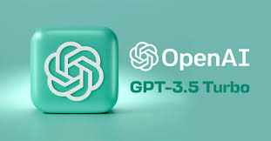


Tech Stack
LLM: GPT-3.5 via OpenAI for language understanding and generation.
Embedding Model: text-embedding-ada-002 for high-quality vector embeddings.
Vector Database: Pinecone for efficient similarity search and retrieval.
YouTube Transcript API: Extracts transcripts directly from YouTube videos.
LangChain Framework: Seamlessly integrates agents, tools, and memory.
Deployment: Hosted using Gardio.
Optional: Add other tools like tqdm for progress tracking or
dotenv for secure API key handling.

Slide 7
Evaluation with LangSmith 📊
🔍 How We Evaluate the Chatbot
📌 Using LangSmith for:
Checking how each agent, vector, and tool works
Monitoring query performance & retrieval accuracy
Testing agent decision-making in multi-step interactions
💡 Ensures chatbot accuracy & efficiency!
Chat with it severel times to see if it give appropriate answers.

Slide 8
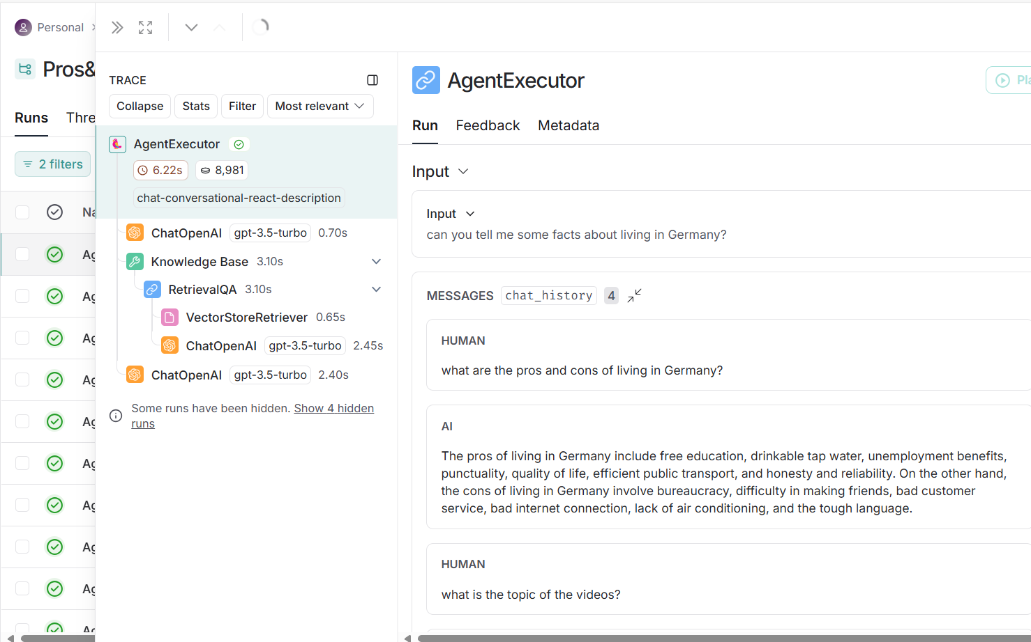
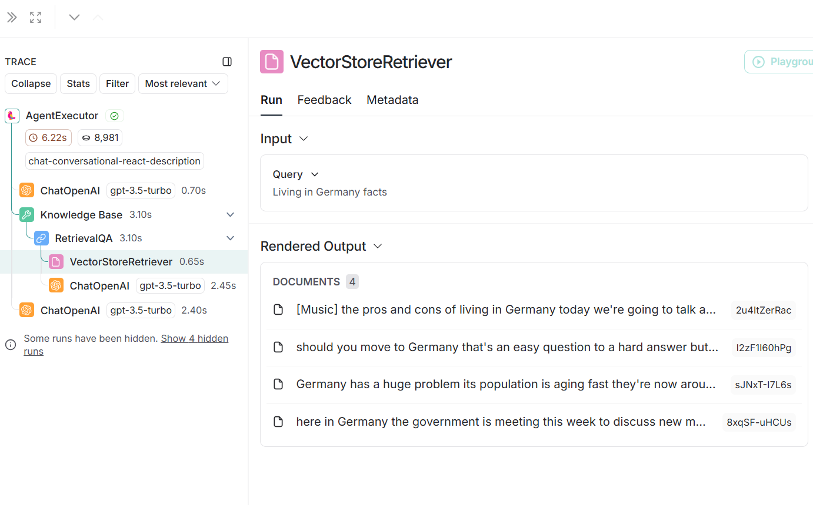
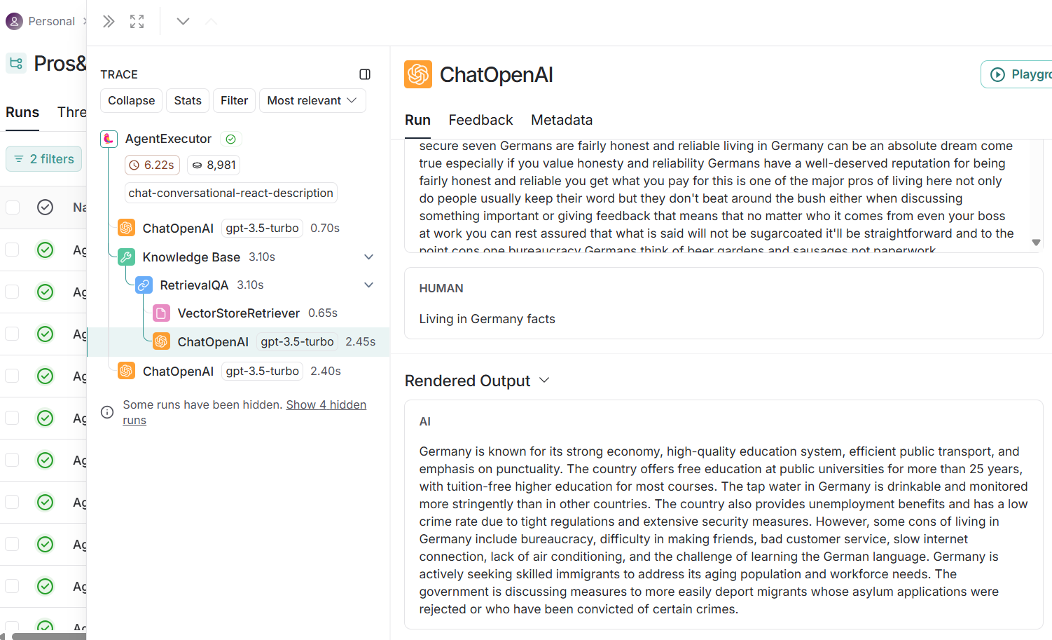
Evaluation with LangSmith 📊

Slide 9

Key Takeaways
"Our chatbot bridges the gap between scattered video content and actionable insights."
Benefits:
Extracts key information quickly.
Scales to other topics and languages.
Simple deployment with Gardio for real-world applications.
Call-to-Action: "Explore how AI can transform content retrieval and conversational experiences!"

Slide 10
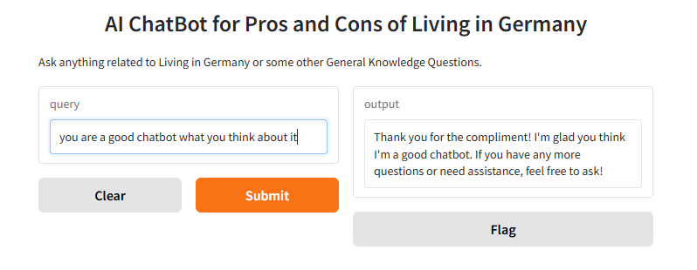
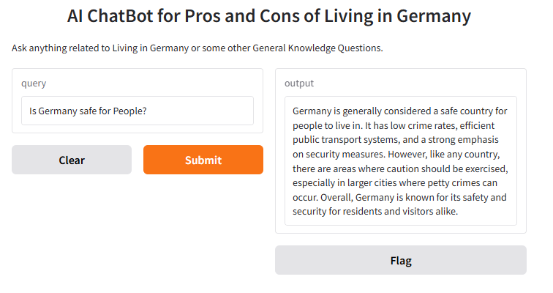
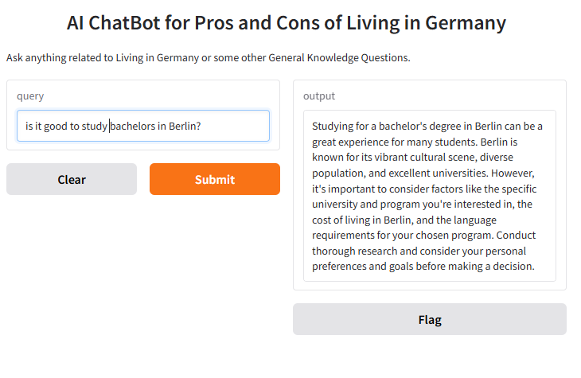
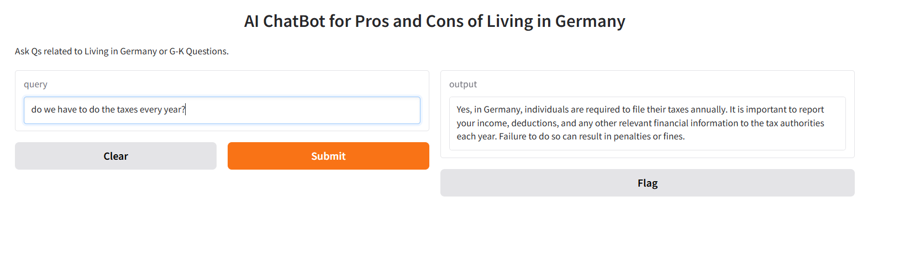
AIChatbot Deployment with Gardio
🖼️ Results of chatbot running on Gardio: 📌 Example queries:
“Is Germany safe for People?”
“Do we have to do the taxes every year?
“Is it good to study Bachlors in Berlin?”

Slide 11
Conclusion
✅ AI chatbot simplifies information retrieval from YouTube. ✅ Fast, accurate & scalable solution for travelers, expats, and students. ✅ Future Potential: Expandable to other countries/topics!
🌟 "AI-powered answers at your fingertips—no more long videos!"

